Slide 1

Foundational Skills Program
Course Title: Software Testing
Date: April 17, 2026
Md. Golam Mostofa
AI/ML-QA Engineer, Bizzntek Ltd
and
Trainer2 Name
Trainer2 Designation

Slide 2
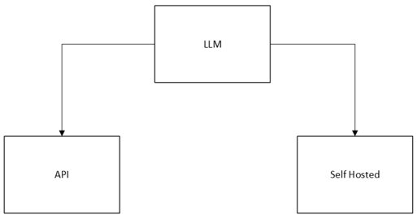
AI Model Test
LLM Come From
LLM stands for Large Language Model
Trained on massive amounts of text data from the internet, books, and articles
Learns patterns in language to generate human-like responses
Based on the Transformer architecture, introduced by Google in 2017
Major developers include OpenAI, Google, Meta, and Anthropic
Requires large-scale computing power (GPUs/TPUs) to train
Examples: GPT-4, Gemini, Claude, Llama

Slide 3
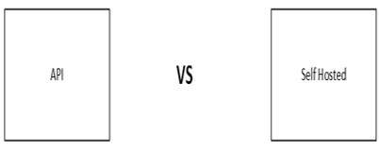
AI Model Test
The Dilemma
Most LLMs run on cloud servers, requiring internet access
Sending data to external servers raises privacy concerns
Cloud-based AI can be costly for frequent use
Organizations become dependent on third-party providers
Risk of data leakage for sensitive or confidential information
Question: Can we run powerful AI locally without sharing our data?

Slide 4

AI Model Test
Intro Ollama
Ollama is a free, open-source tool to run LLMs locally
No internet required after initial setup
Works on macOS, Linux, and Windows
Simple command-line interface to download and manage models
Supports many popular models: Llama, Mistral, Gemma, and more
Keeps all data on your own machine, fully private

Slide 5
AI Model Test
Ollama Installation
Visit the official website: https://ollama.com
Download the installer for your operating system
Run the installer and follow the on-screen steps
Open a terminal after installation
Verify by typing: ollama --version
You should see the installed version number if successful

Slide 6
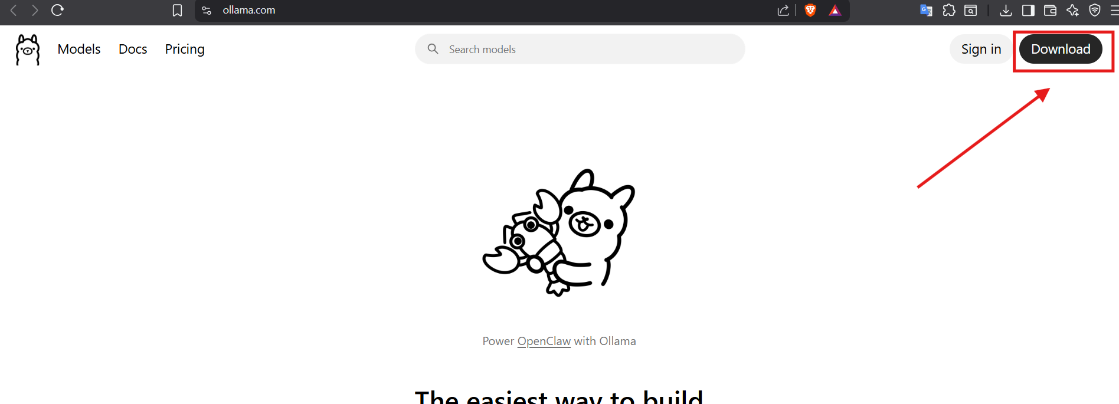
Ollama Installation
Visit the official website: https://ollama.com
Click on Download

Slide 7
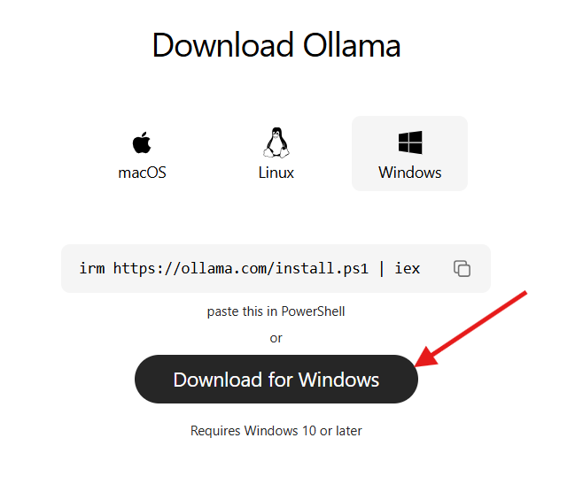
Ollama Installation
Download the installer for your operating system
Run the installer and follow the on-screen steps
Open a terminal after installation
Verify by typing: ollama --version
You should see the installed version number if successful

Slide 8
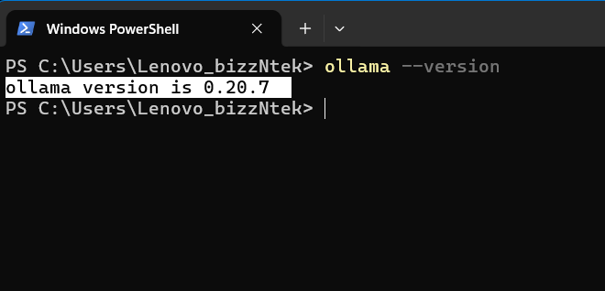
Ollama Installation
Open a terminal after installation
Verify by typing: ollama --version
You should see the installed version number if successful

Slide 9
AI Model Test
Intro Llama3.1: 8b Model
Llama 3.1 is Meta's open-weight language model
8B means 8 billion parameters
Lightweight enough to run on a standard laptop
Supports multiple languages including English and Bengali
Use cases: Q&A, summarization, coding, reasoning
Ideal for local AI learning and experimentation
Completely free to use and modify

Slide 10
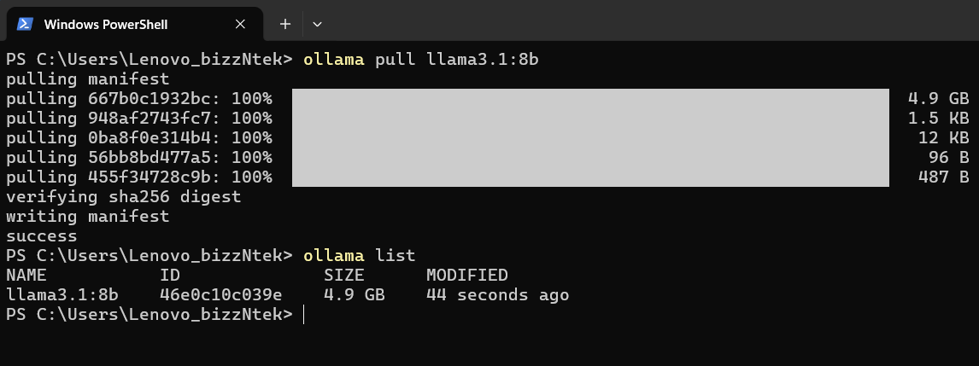
AI Model Test
Install Llama3.1: 8b Model
Open your terminal
Run the command: ollama pull llama3.1:8b
Ollama will begin downloading the model (~4.7 GB)
Ensure you have a stable internet connection during download
Wait for the download to fully complete before testing
Confirm installation by running: ollama list

Slide 11
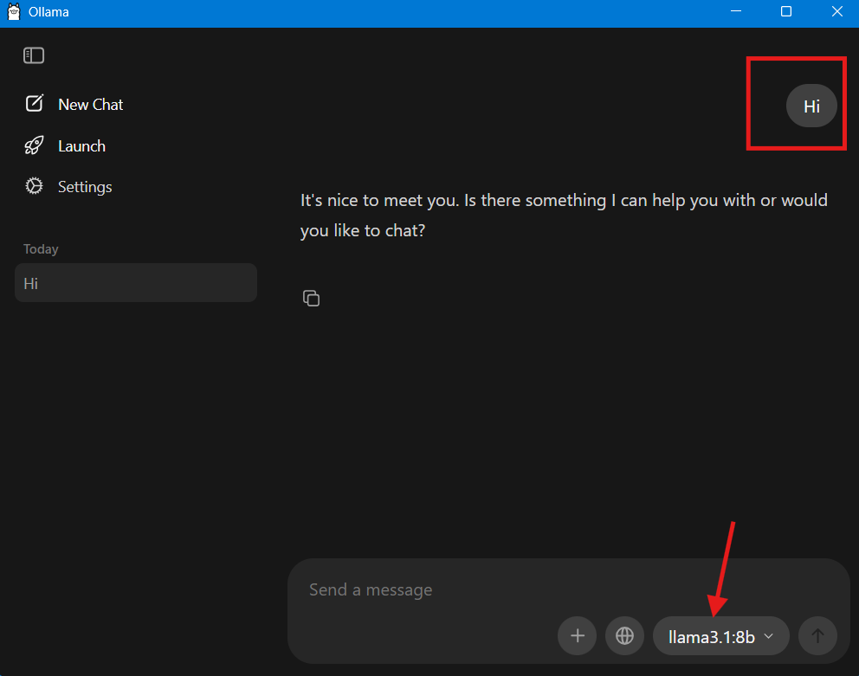
AI Model Test
Inference the Model
Open your Ollama
Select: llama31:8b Model
Type 'hi'

Slide 12
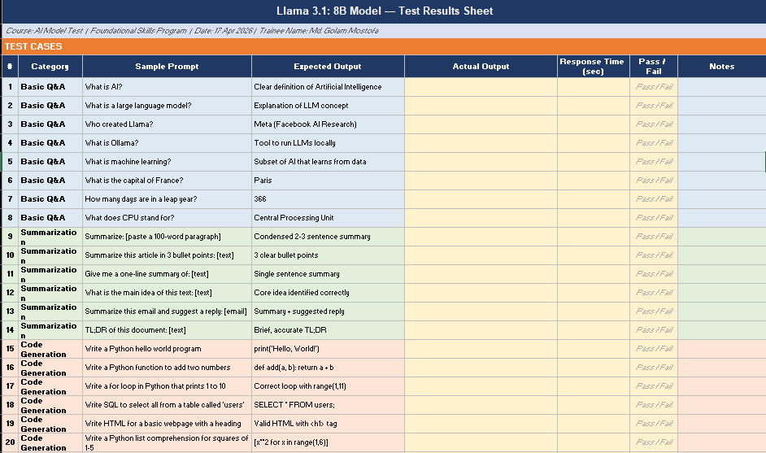
AI Model Test
Test Llama3.1: 8b Model
Start a chat session by running: ollama run llama3.1:8b
Test Sheet: llama_test_sheet.xlsx
To exit, type /bye or press Ctrl+D

Slide 13
Q&A
Any Questions?

Slide 14
Thanks
Md. Golam Mostofa
golam.mostofa@bizzntek.com

